Slide 1
CASE STUDY on machine learning
Prediction of MINIMUM AND MAXIMUM Temperature DURING WW2
Presented by
SRUTI DUTTA
Mentor
Mr.Bose
Top Mentor

Slide 2
About Dataset:
Context: While exploring the Aerial Bombing Operations of World War II and recalling that the D-Day landings were nearly postponed due to poor weather, I sought out weather reports from the period to compare with missions in the bombing operations dataset.
Content: The dataset contains information on weather conditions recorded on each day at various weather stations around the world. Information includes precipitation, snowfall, temperatures, wind speed and whether the day included thunderstorms or other poor weather conditions.
Acknowledgements: The data are taken from the United States National Oceanic and Atmospheric Administration - National Centers for Environmental Information website: https://www.ncdc.noaa.gov/data-access/land-based-station-data/land-based-datasets/world-war-ii-era-data.
Inspiration: This dataset is mostly to assist with the analysis of the Aerial Bombing Operations dataset.

Slide 3
Goal:
The Goal or the objective of this study is to predict the max and min temp based on several parameters and represent it in a visual form.

Slide 4
Data pre-processing:
Data Cleaning steps:
Data Type conversion.
Drop the irrelevant and unnecessary columns.
Replacing incorrectly entered values.
Handling Null Values.

Slide 5
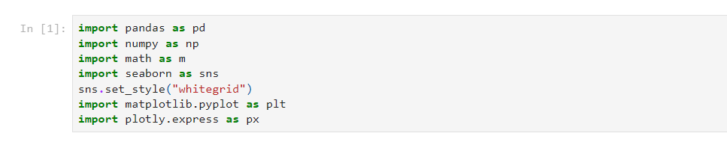
Importing of Packages:

Slide 6
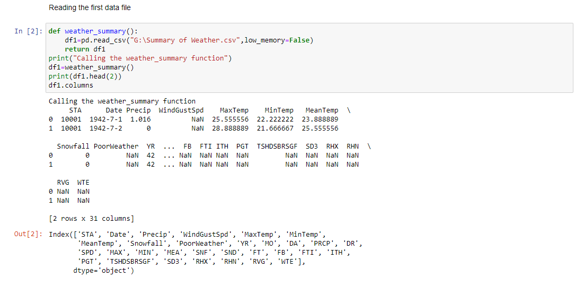
Loading Datasets:

Slide 7
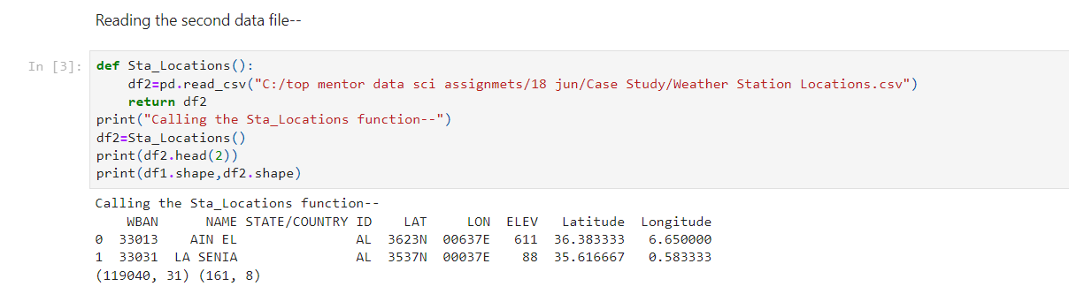
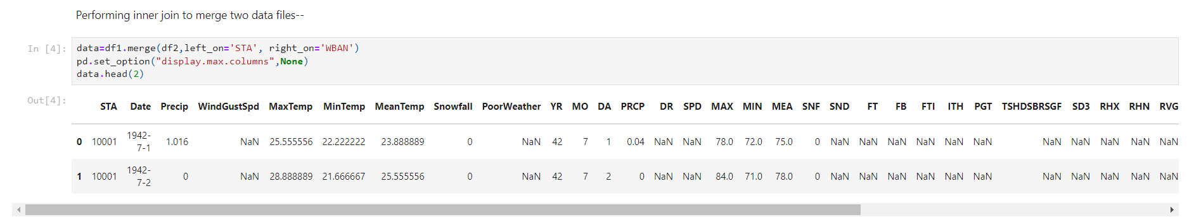

Slide 8
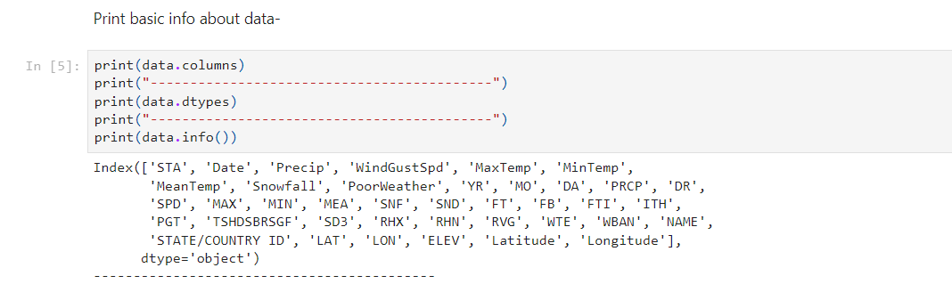

Slide 9
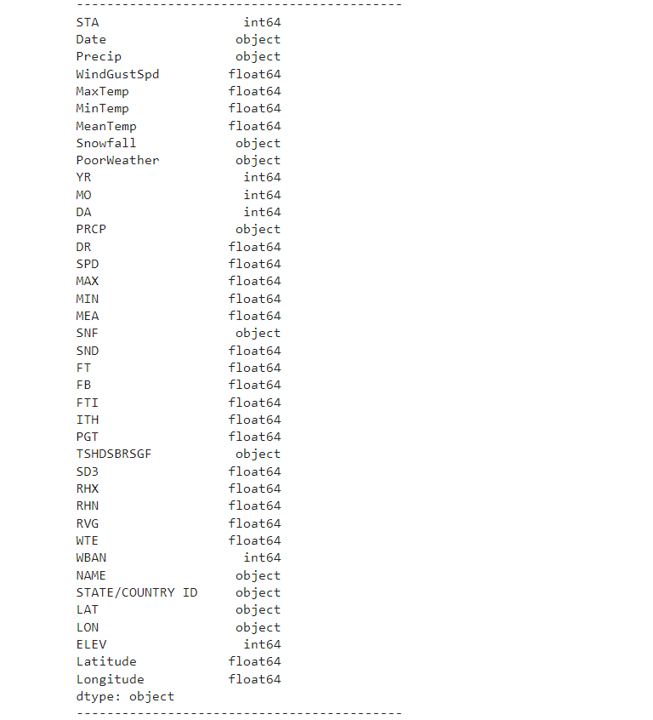

Slide 10
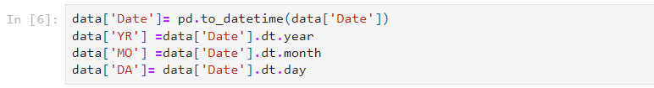
Data Cleaning:
Converting string Date time into Python Date time object:

Slide 11
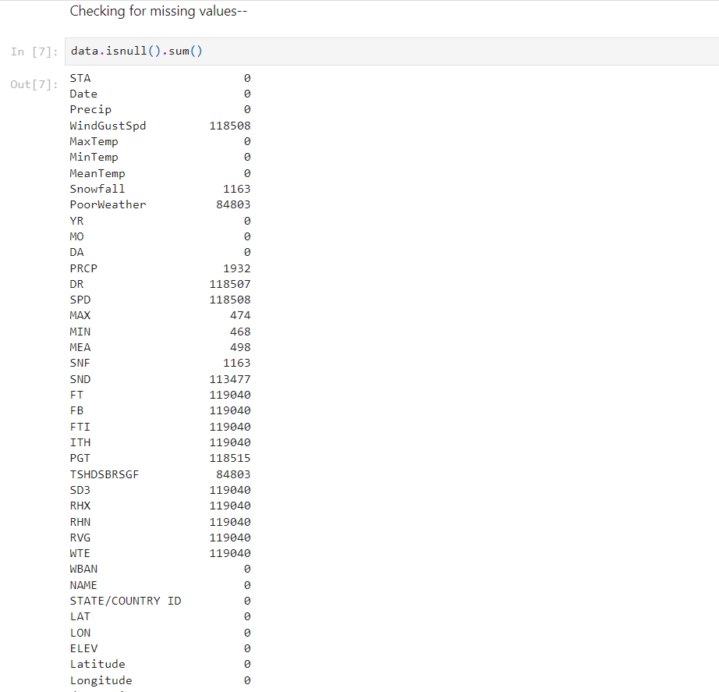
Checking for Missing Values:

Slide 12
1. We have to predict min and max temp based on other parameters. Hence, min and max temp are our output parameters.
As of now, we have total 37 parameters excluding min and max temperature and these are—
['STA', 'Date', 'Precip', 'WindGustSpd', 'MeanTemp', 'Snowfall', 'PoorWeather', 'YR', 'MO', 'DA', 'PRCP', 'DR','SPD', 'MAX', 'MIN', 'MEA', 'SNF', 'SND', 'FT', 'FB', 'FTI', 'ITH','PGT', 'TSHDSBRSGF', 'SD3', 'RHX', 'RHN', 'RVG', 'WTE', 'WBAN', 'NAME','STATE/COUNTRY ID', 'LAT', 'LON', 'ELEV', 'Latitude', 'Longitude']
but, we have to decide which ones are relevant.
2. Afer basic understanding of a data we are going to keep only relevant columns and these are- ['STA', 'Date', 'Precip','WindGustSpd', 'MaxTemp', 'MinTemp','MeanTemp', 'Snowfall', 'PoorWeather', 'YR', 'MO', 'DA', 'PRCP', 'WBAN','NAME', 'STATE/COUNTRY ID', 'Latitude', 'Longitude']
Explanation-- a.'MAX'--This column indicates Maximum temperature in degrees Fahrenheit.However, we alredy have a column 'MaxTemp' which notes down Max temp in degree celcius. Therefore, we dont need to have another parameter for Max temperature. Similarly, if we take into account 'MIN', 'MEA', 'SNF','LAT', 'LON' this columns we already have another column noting down this parameters. so , we are dropping this columns. b.['DR','SPD','SND','FT', 'FB', 'FTI', 'ITH','PGT', 'TSHDSBRSGF', 'SD3', 'RHX', 'RHN', 'RVG', 'WTE' ] all these columns have either no data or have more than 95% data as null as per above description. hence this columns are of no much use. consequently, we are dropping this columns as well. c.'PRCP'-- we are going to use this column only to split our data into train and test.

Slide 13
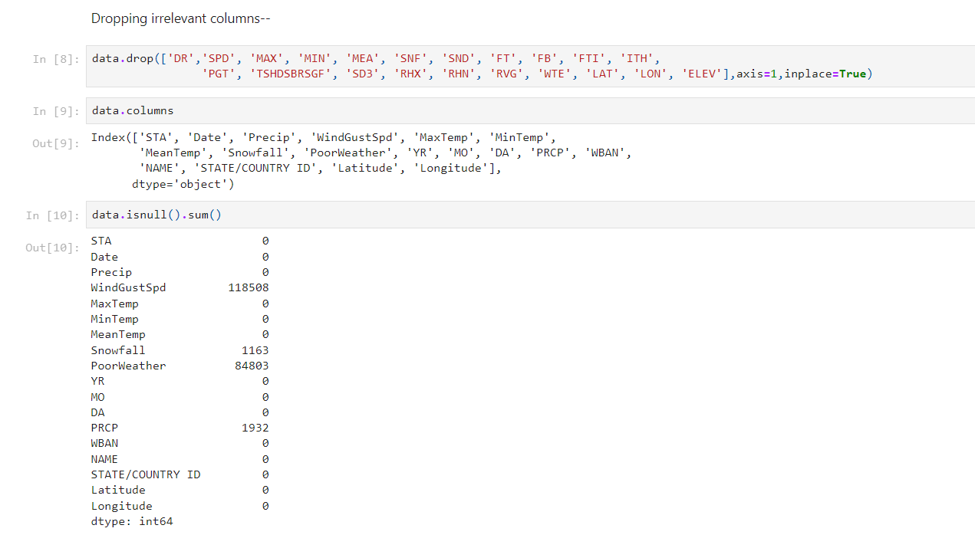
Dropping irrelevant columns:

Slide 14
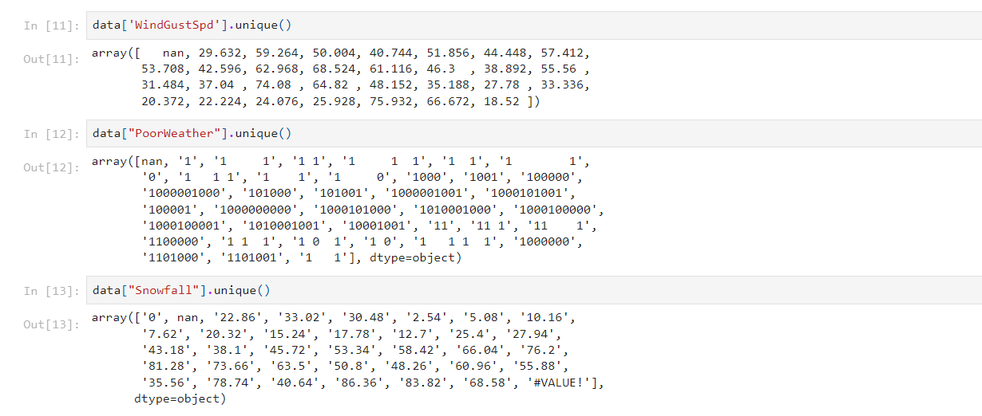
Checking Unique Values:

Slide 15
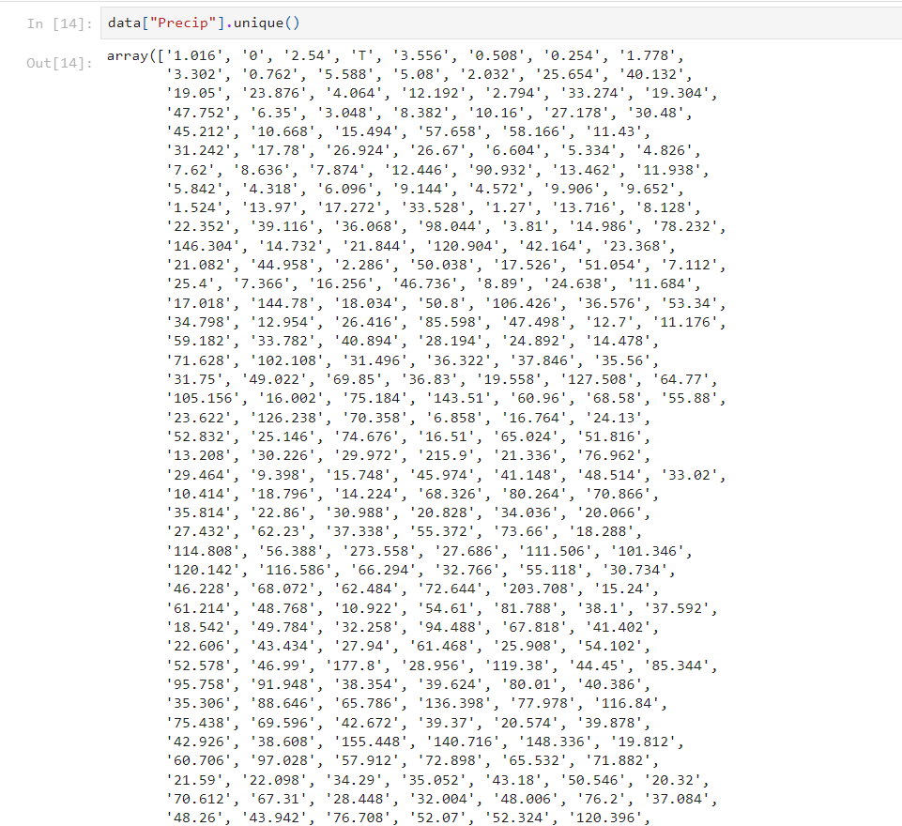

Slide 16
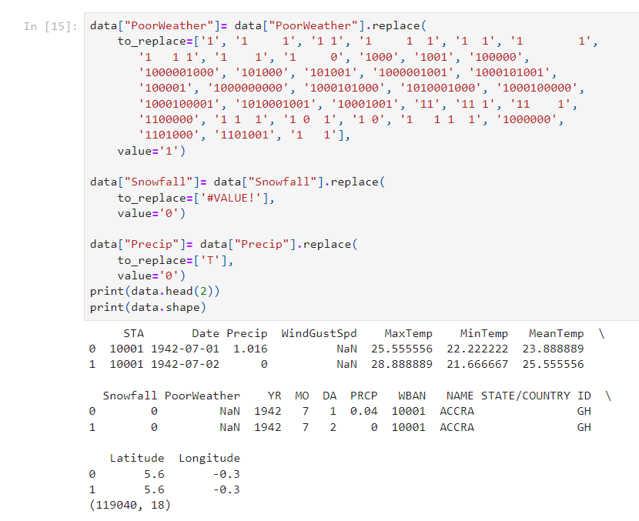
Replacing incorrectly entered values:

Slide 17
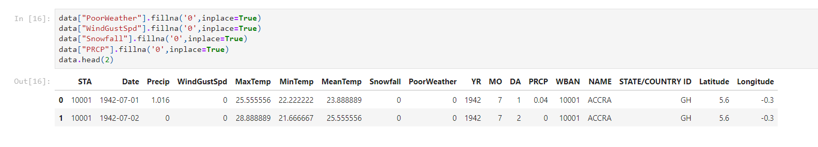
Replacing NaN with zeros:

Slide 18
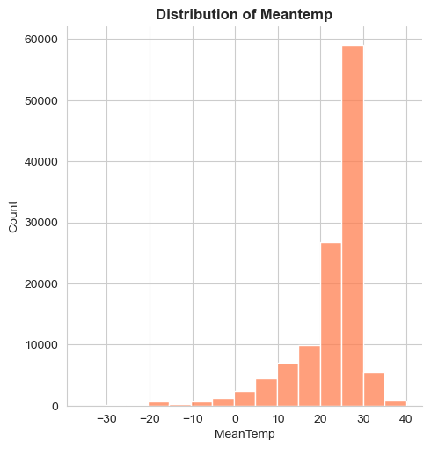
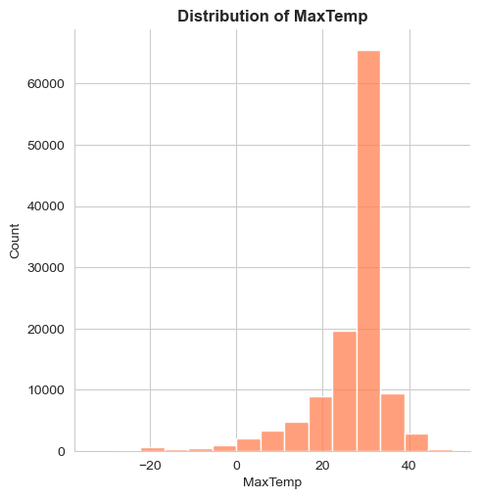
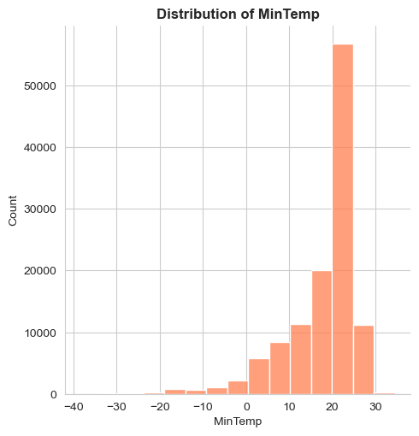
Exploratory Data Analysis:
Mostly Mean Temperature is ranging between 25 to 30°C with highest reaching upto 40°C.
Mostly Maximum Temperature is ranging around 30°C with highest surpassing 40°C.
Mostly Minimum Temperature is ranging between 20 to 25°C with highest reaching upto 30°C.

Slide 19
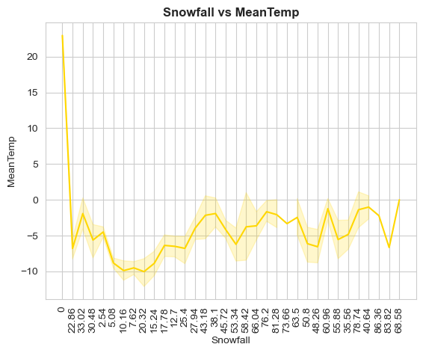
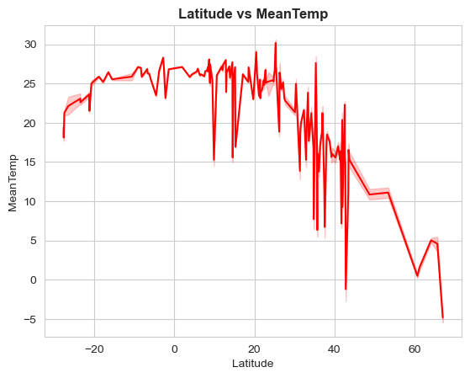
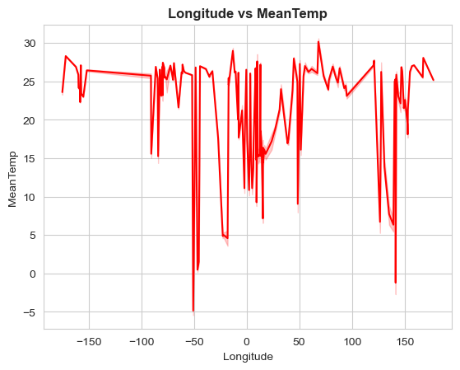
From above lineplot we can say that during snowfall mean Temperature is dropping below 0°C.
Above lineplot indicates that as Latitude is increasing Mean Temperature is dropping.
From above lineplot we cant make any conclusive remark about relation between Longitude and Mean Temperature , as temperature is fluctuating.

Slide 20
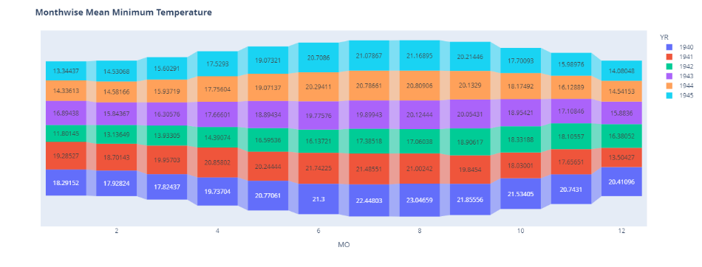
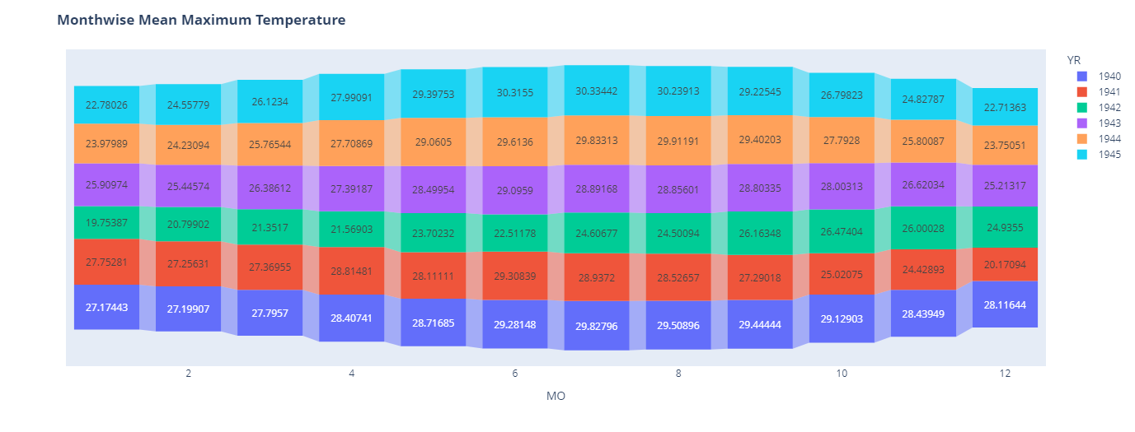
The Mean minimum temperature has dropped upto 11.80°C and this was observed in the first month of 1942.
The Mean maximum temperature has reached slightly above 30°C and this was observed during june to august of 1945.

Slide 21
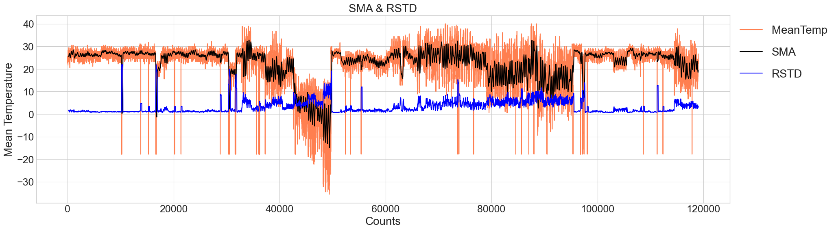
Data of Mean Temperature is stationary as plots of Simple moving average and Rolling standard deviation are running parallel to the X-axis.

Slide 22
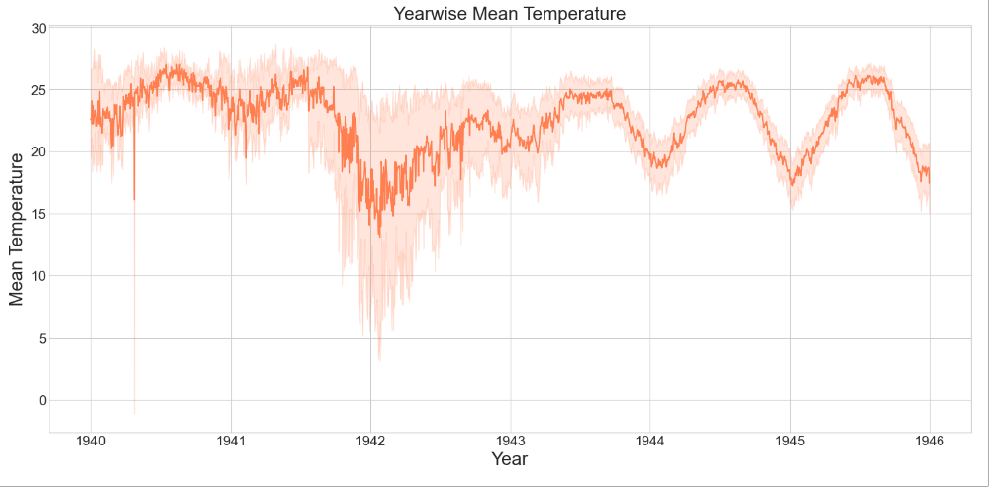
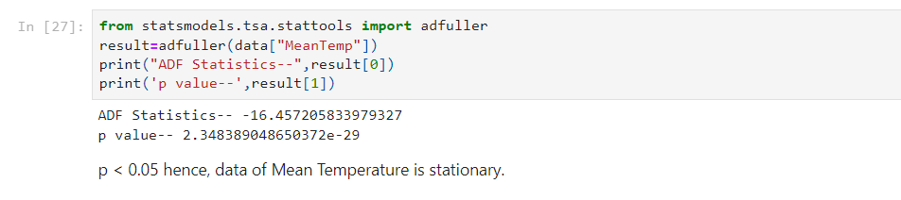

Slide 23
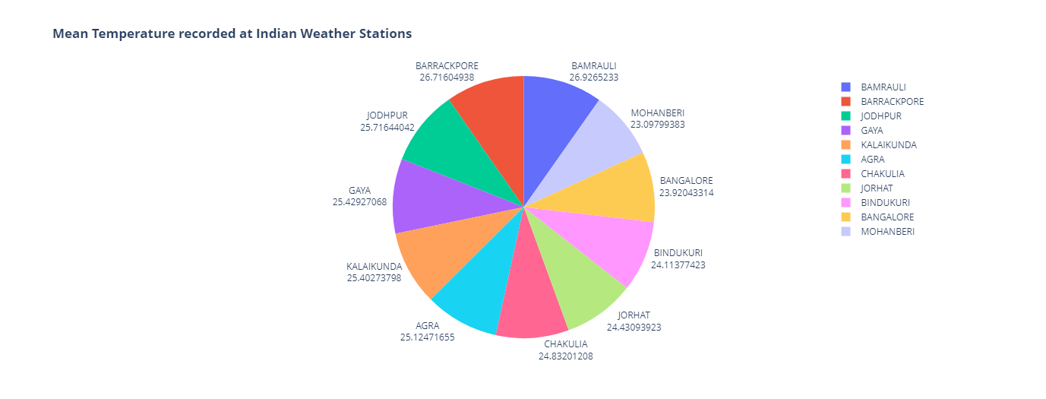
Lets focus on Indian stations:
Our data includes records from 11 weather stations. lets, analyze mean temperature around some areas.

Slide 24
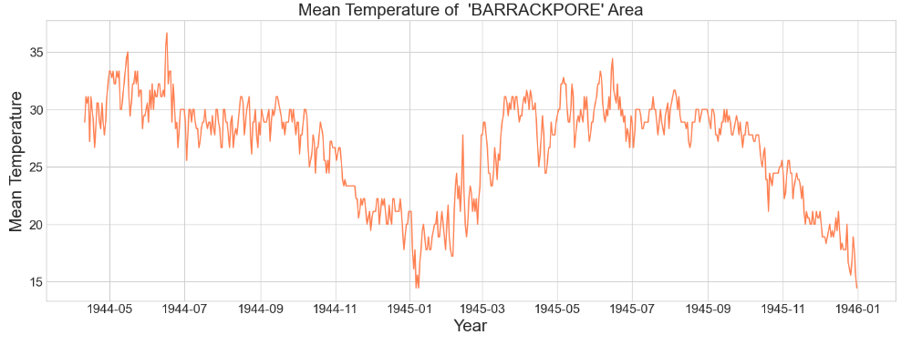
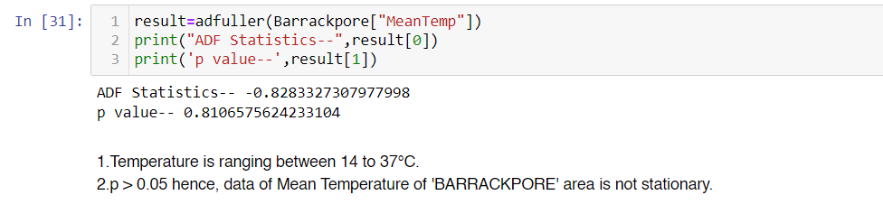
Mean Temperature of 'BARRACKPORE' Area:
Lets visualize the Mean Temperature of 'BARRACKPORE' Area. We have temperature record from 1944 to 1945.

Slide 25
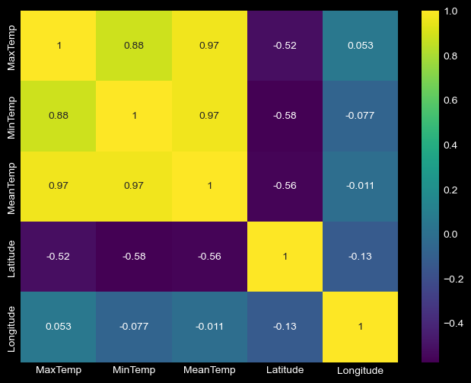
Correlation Matrix Heatmap:
Latitude and MaxTemp are moderately negatively correlated. (r= - 0.52)
Latitude and MinTemp are moderately negatively correlated. (r= - 0.58)
Latitude and MeanTemp are moderately negatively correlated. (r= - 0.56)
Longitude and MaxTemp have no association. (r= - 0.053)
Longitude and MinTemp have no association. (r= - 0.077)
Longitude and MeanTemp have no association. (r= - 0.011)

Slide 26
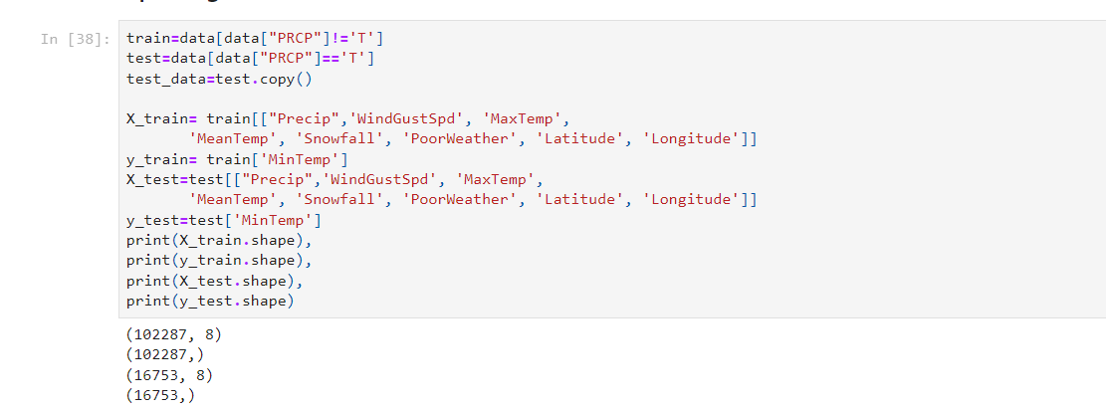
Splitting of data: PRCP column have ' T ' values and this is our test data. Lets split the data to predict Minimum Temperature:

Slide 27
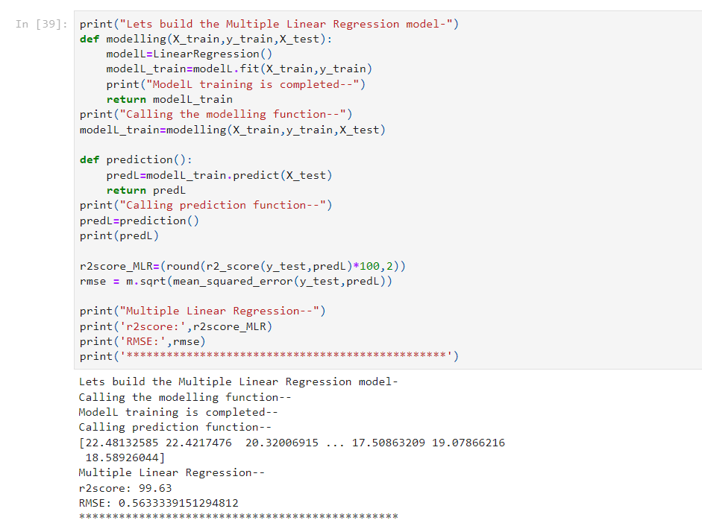
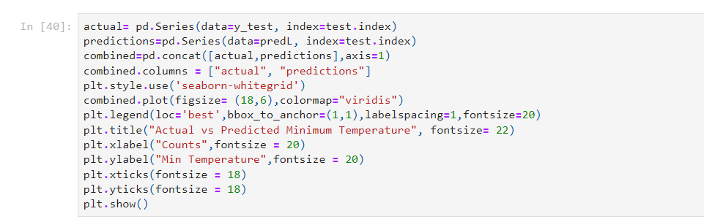
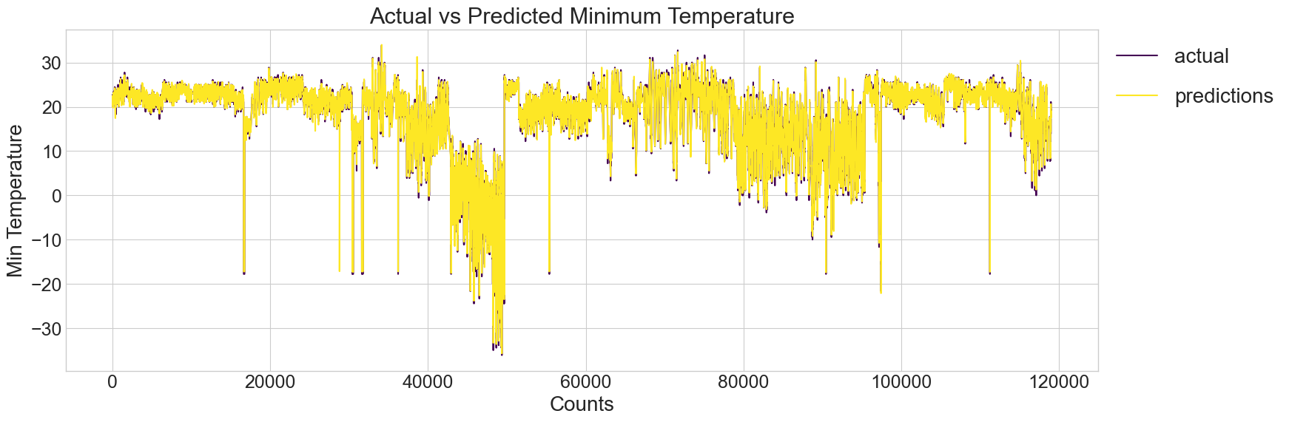
Building of a Model to Predict Minimum Temperature:
1. Multiple Linear Regression:

Slide 28
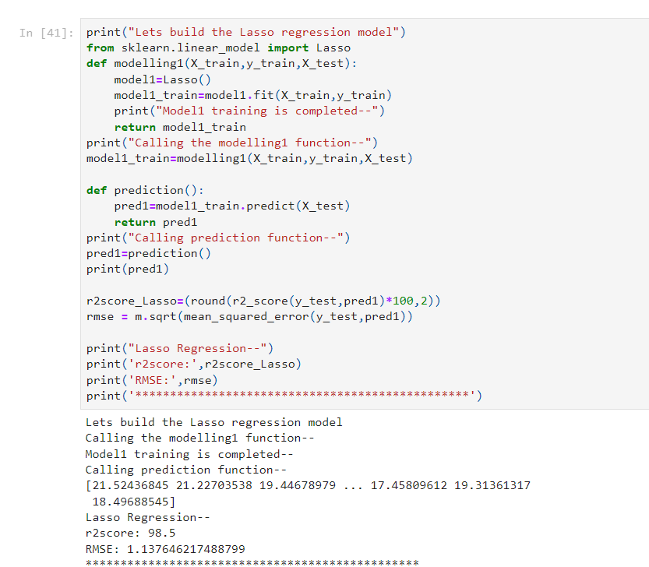
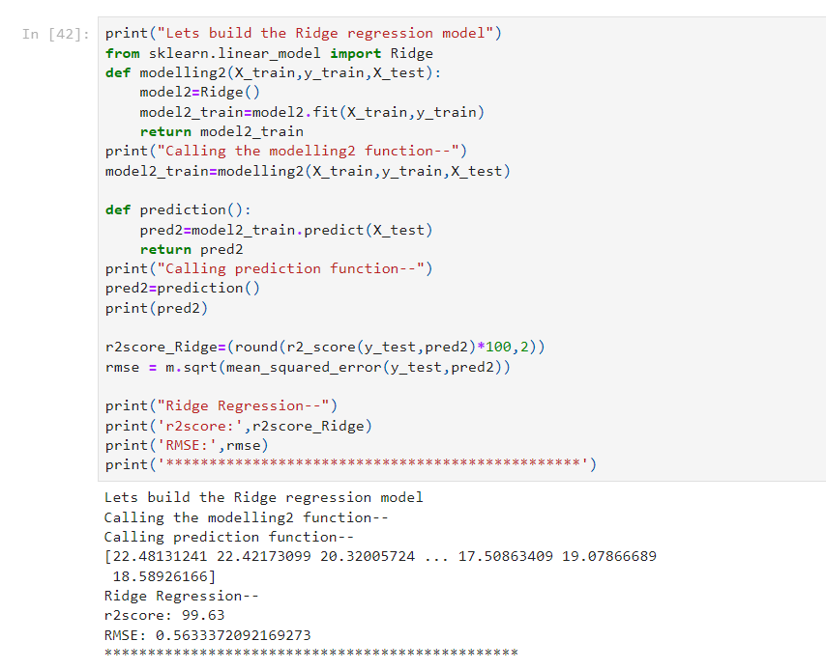
2. Lasso Regression:
3. Ridge Regression:

Slide 29
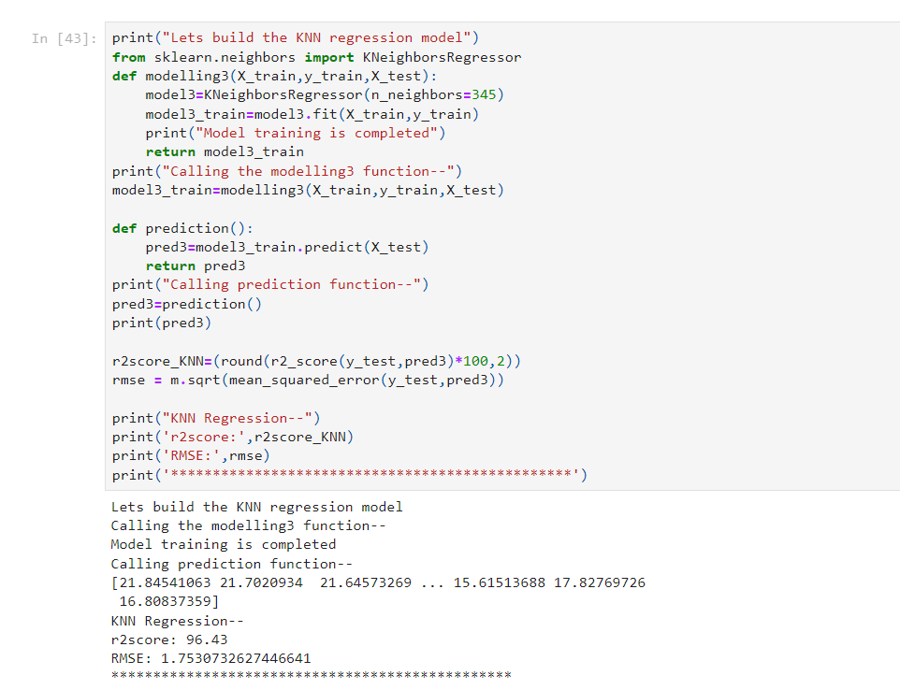
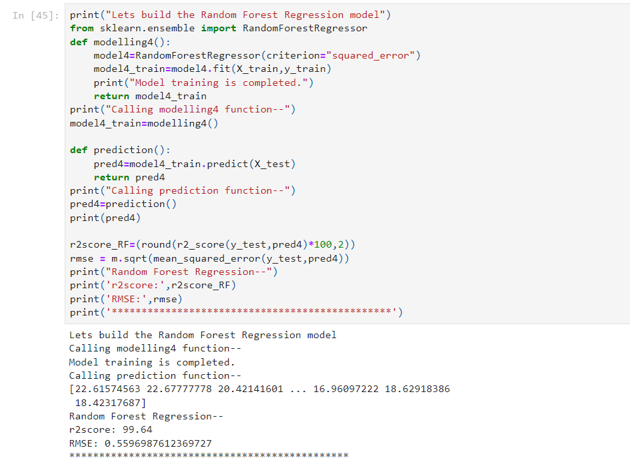
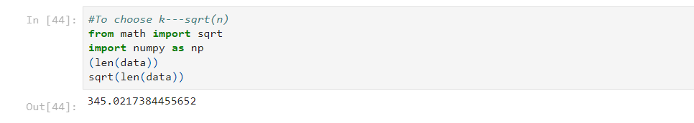
3. KNN Regression:
4. Random Forest Regression:

Slide 30
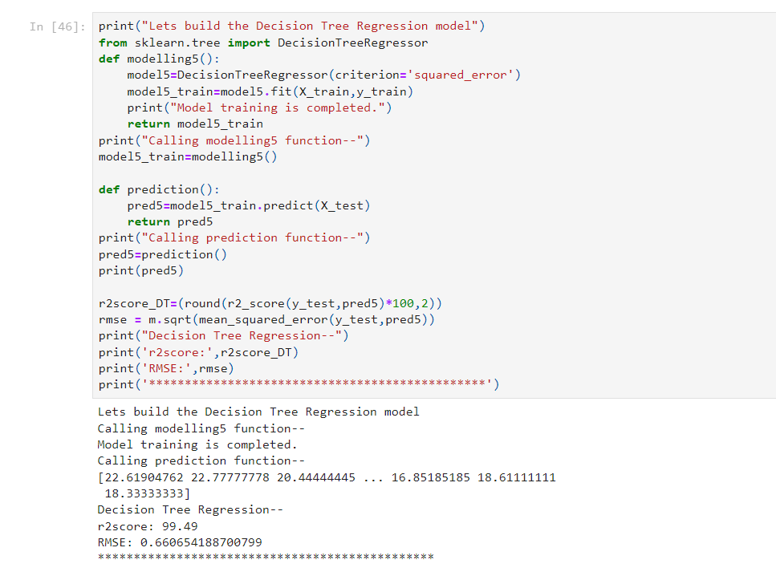
5. Decision Tree Regression:

Slide 31
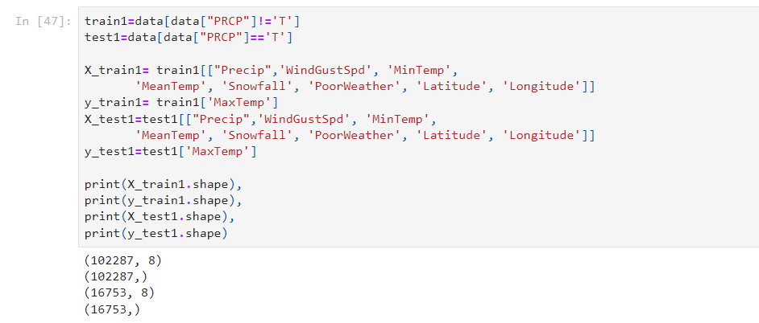
Splitting of data: PRCP column have ' T ' values and this is our test data. Lets split the data to predict Maximum Temperature:

Slide 32
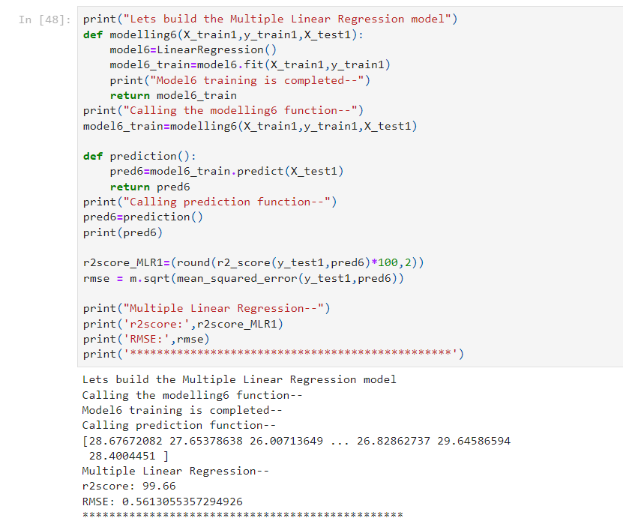
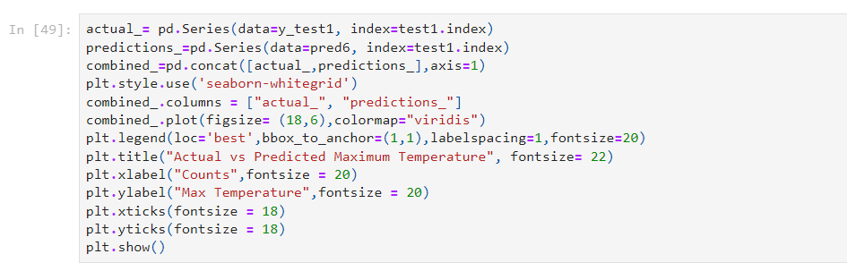
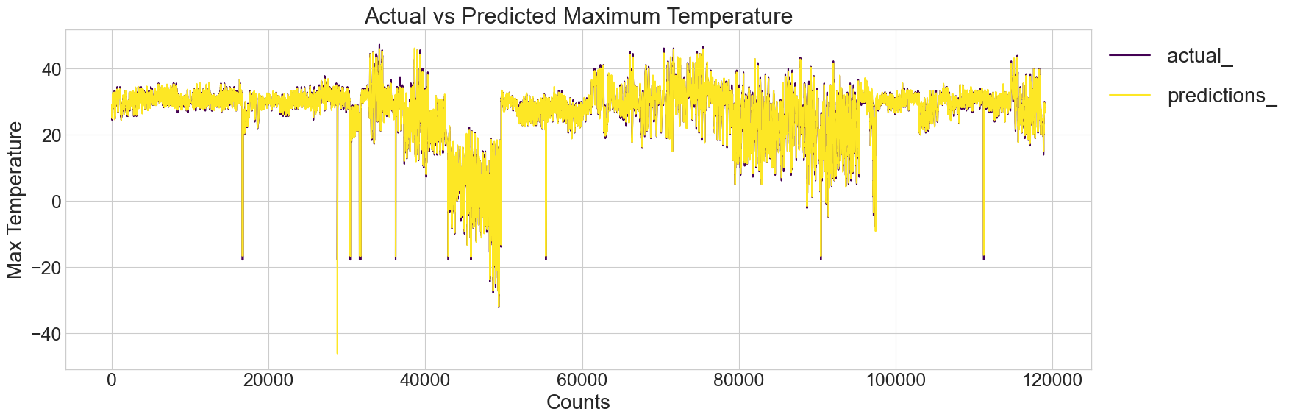
Building of a Model to Predict Maximum Temperature:
1. Multiple Linear Regression:

Slide 33
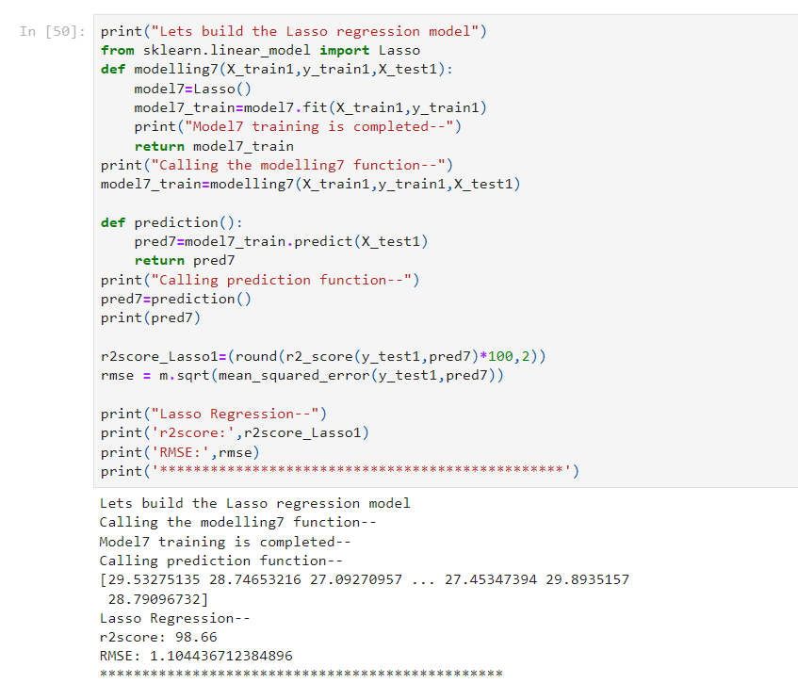
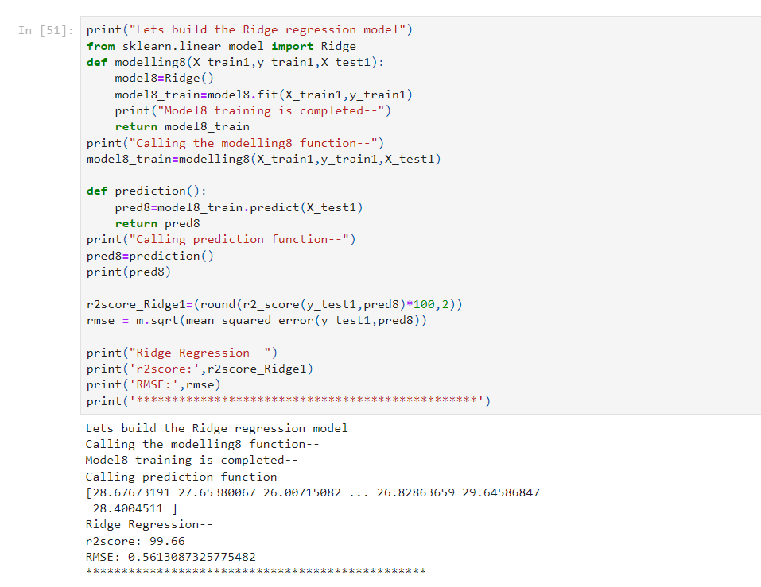
2. Lasso Regression:
3. Ridge Regression:

Slide 34
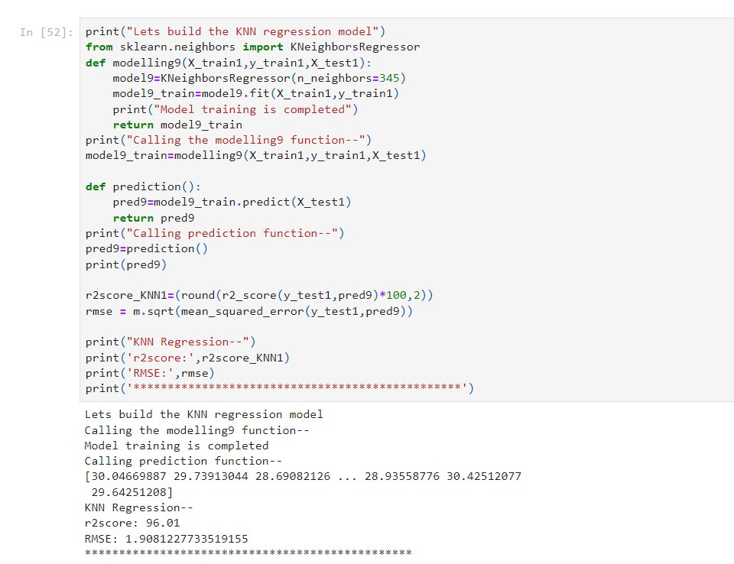
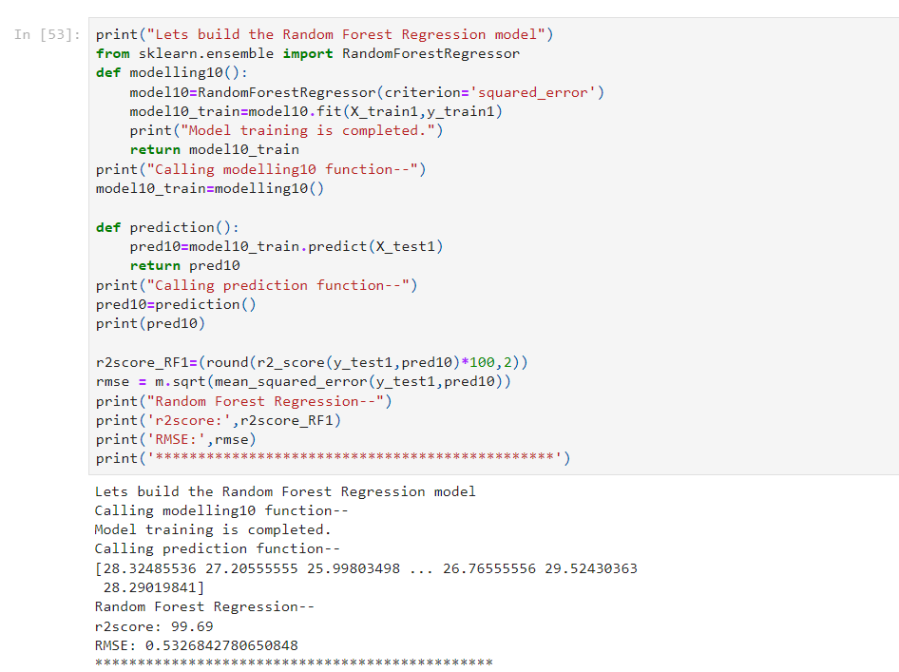
3. KNN Regression:
4. Random Forest Regression:

Slide 35
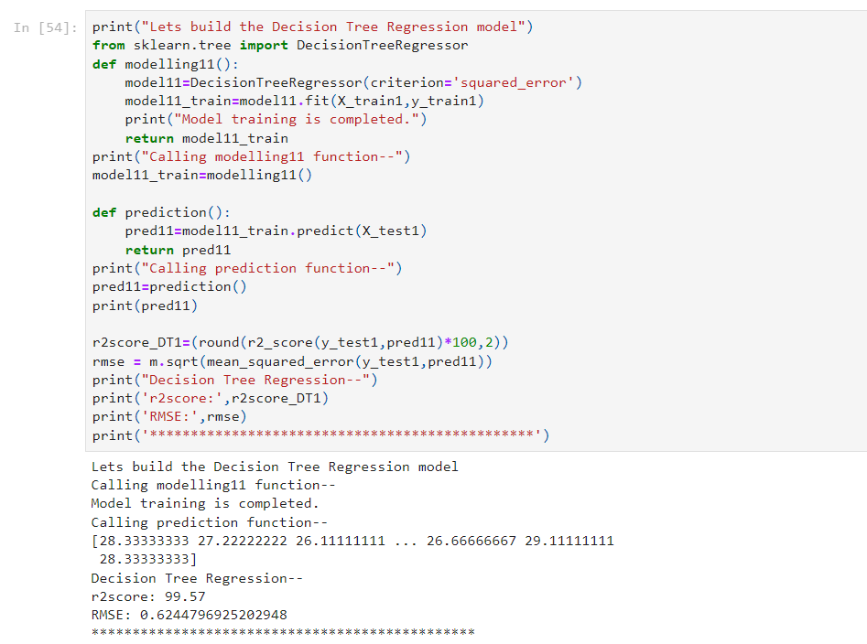
5. Decision Tree Regression:

Slide 36
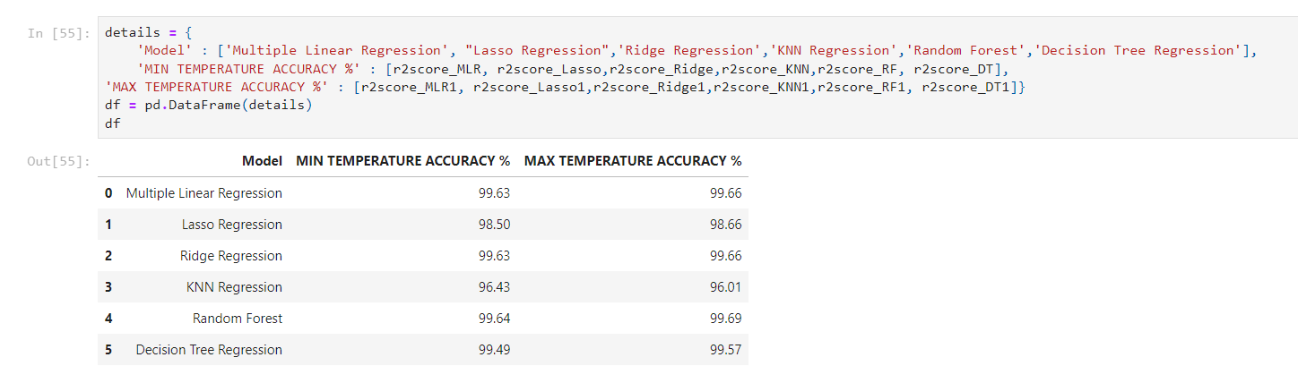
Almost all the models are giving accuracy around 99%. We are choosing Temperatures predicted by Multiple Linear Regression model.

Slide 37
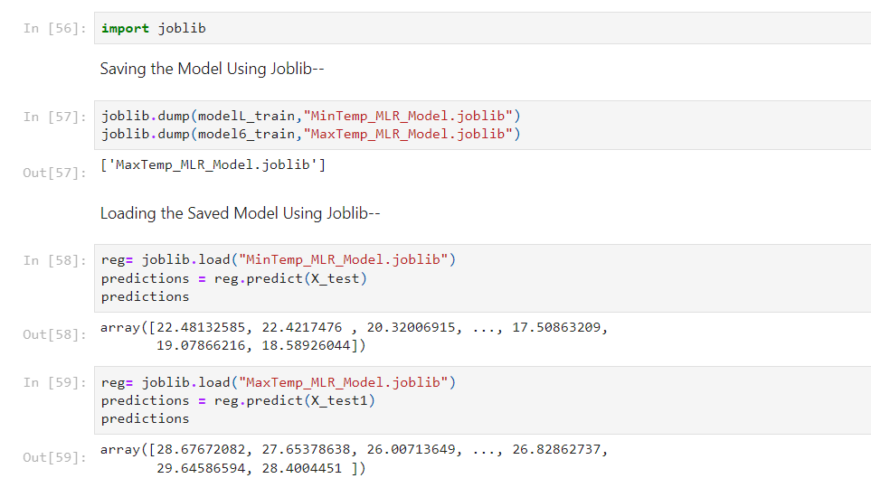
Saving the model using joblib:
We save our models using joblib. Besides we test the models to predict Minimum and Maximum Temperatures.

Slide 38
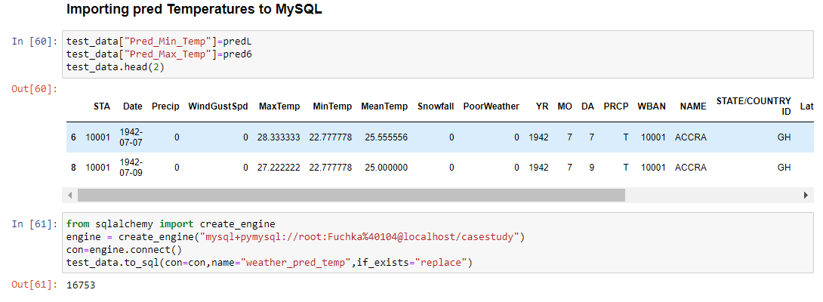
Importing Minimum and Maximum Temperatures predicted by Multiple Linear Regression model to MySQL:

Slide 39


Slide 40


Final Dashboard of predicted Temperatures prepared Using Tableau:

Slide 41



Insights from Dashboard:
From above graphs we can observe that both predicted Min and Max Temperatures are roughly equal as we have selected model with accuracy nearly to 99%.

Slide 42
THANK YOU!!!

